Slide 1

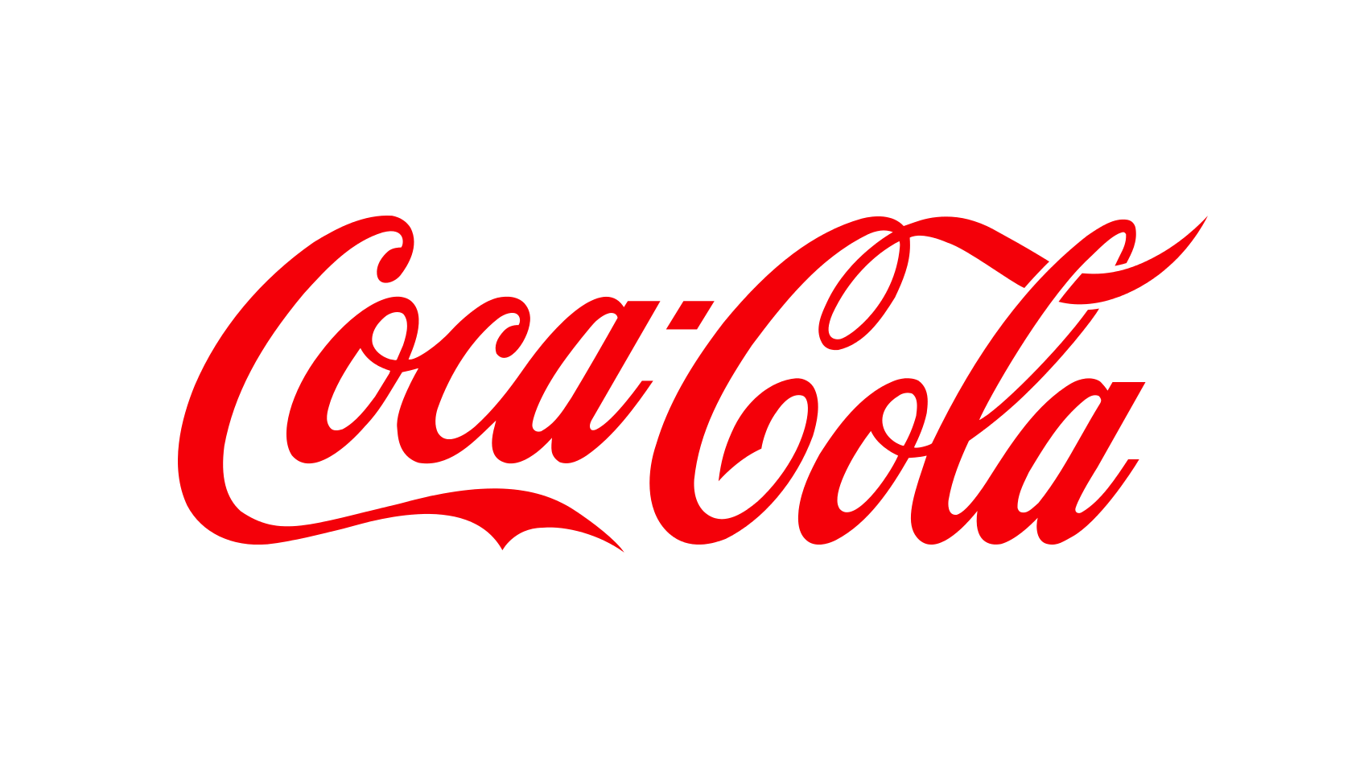
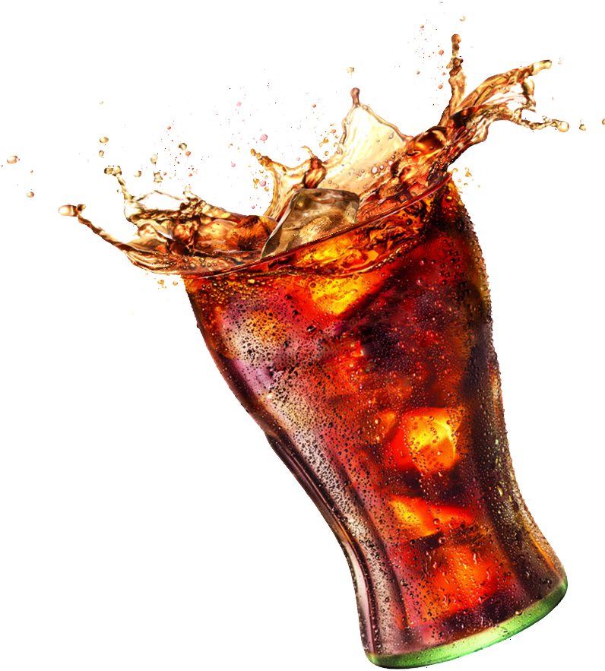

Coca Cola
FINANCIAL ANALYSIS

Slide 2
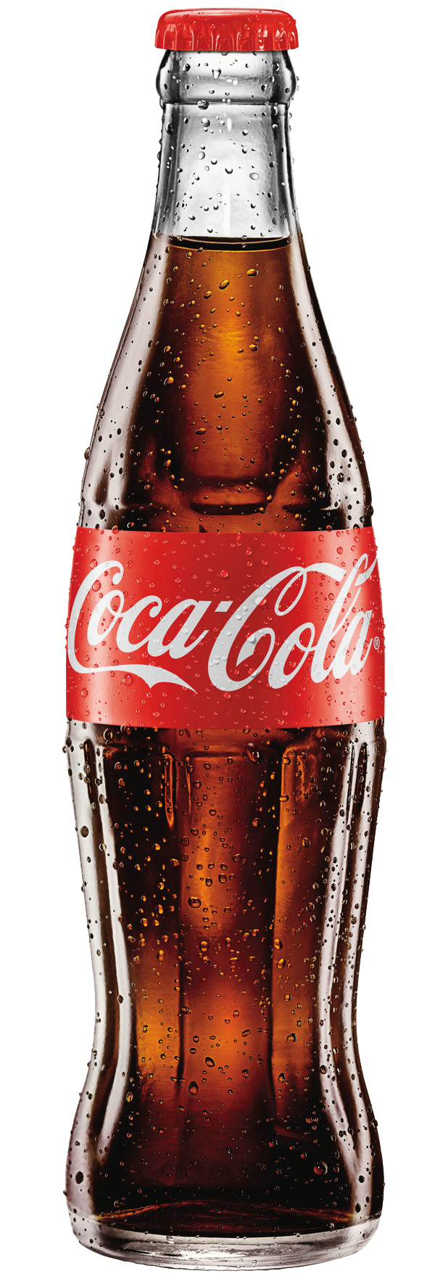
INTRODUCTION
Coca-Cola is one of the world's leading beverage companies, with a history dating back to 1886 when it was first invented by Dr. John S. Pemberton. Over the years, the company has expanded its product line to include a variety of non-alcoholic beverages, including sparkling drinks, juices, sports drinks, and teas.
Coca-Cola has kept up its expansion and growth over the last 10 years. The business generated $33.01 billion in total sales and $7.38 billion in net profits in 2021. The company's present operations are concentrated on the creation of new goods, market expansion, and funding sustainability programmes.
As of March 23, 2023, the stock price of Coca-Cola stands at around $55 per share, indicating a steady upward trajectory. In addition, the company's financial performance has been consistently strong, with a solid balance sheet and healthy revenue growth. Coca-Cola has also continued to innovate and expand its product portfolio to meet the evolving demands of consumers, such as introducing new flavours and investing in healthier beverage options.

Slide 3
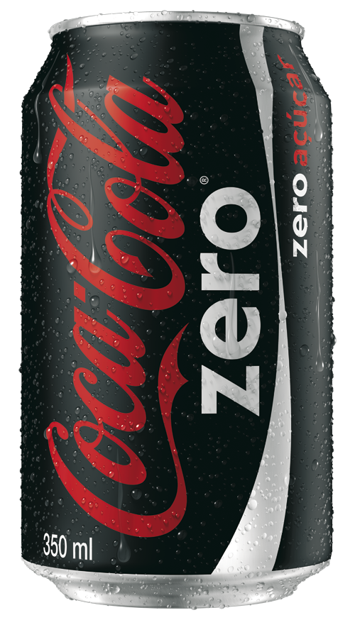
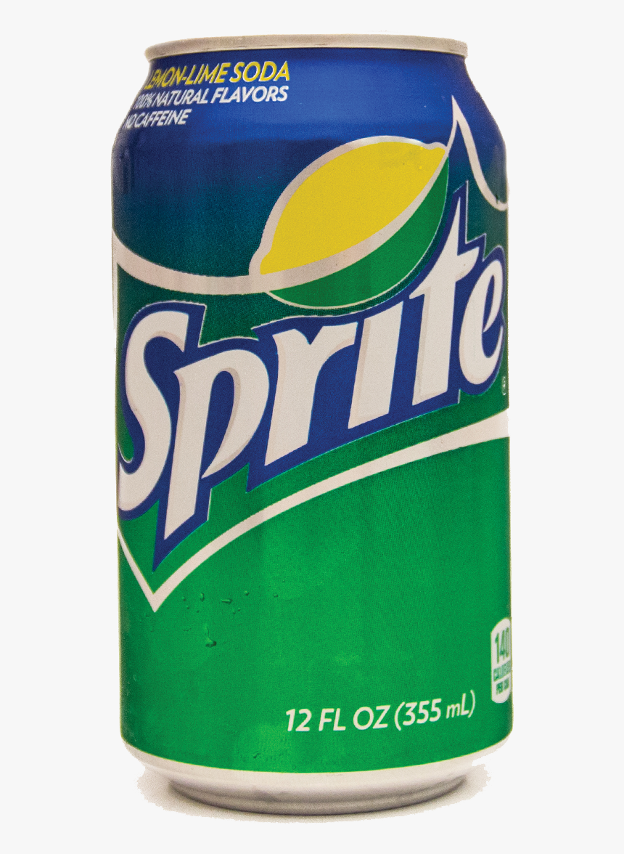
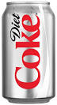
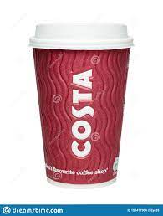
PRODUCTS
Coca-Cola Zero: A zero-calorie version of Coca-Cola.
Sprite: A lemon-lime flavored carbonated soft drink.
Diet Coke: A low-calorie version of Coca-Cola.
Costa Coffee: A coffee shop chain that Coca-Cola acquired in 2018.
In recent years, the company has launched several new products, including Coca-Cola Zero Sugar, Coca-Cola Energy, and Topo Chico Hard Seltzer. Additionally, Coca-Cola has made a significant investment in sustainability initiatives, with a goal of becoming a net-zero company by 2040.

Slide 4
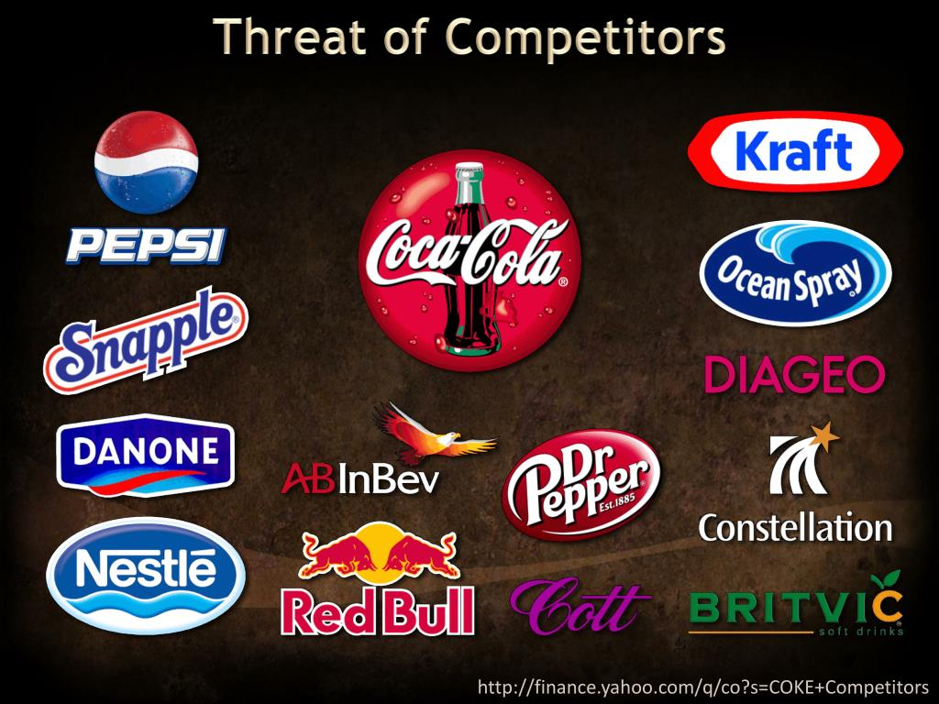

COMPETITORS
The beverage industry is highly competitive, with several major players competing for market share. Coca-Cola's main competitors include PepsiCo, Nestle, Dr. Pepper Snapple, and Keurig . According to Statista, in 2021, Coca-Cola had a global market share of approximately 42%, making it the leading player in the industry.

Slide 5
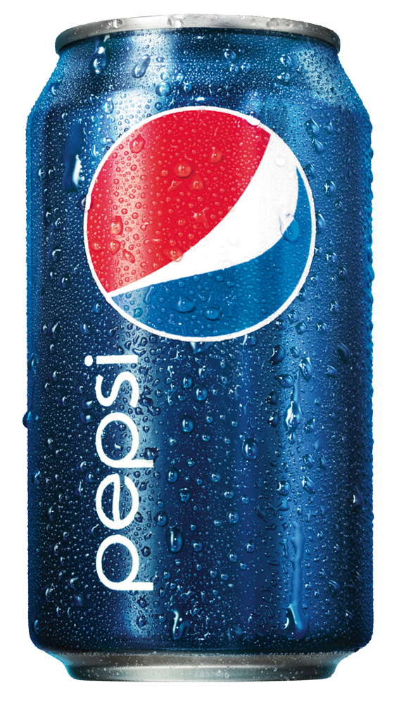
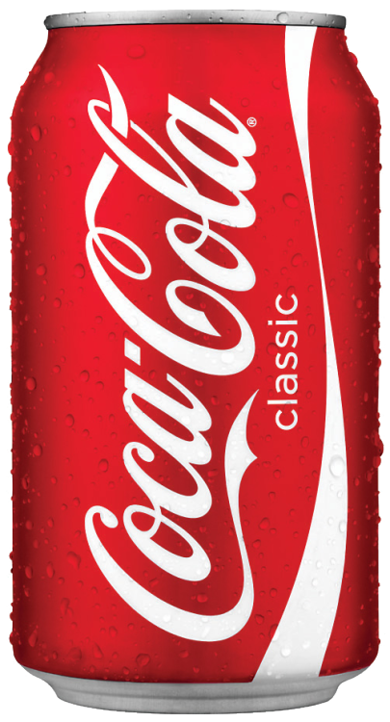
Coca Cola
PepsiCo
Coca-Cola had a global market share
of approximately 42% in 2021
PepsiCo's global market share was
approximately 10.8% in 2021
VS
In 2021, Coca-Cola had a total
revenue of $37.27 billion
PepsiCo had a total revenue
of $75.85 billion
Coca-Cola's net
income was $9.19 billion
PepsiCo's net income
was $10.46 billion.
These financial analytics points can provide a snapshot of the companies' financial performance for 2021, but further analysis may be necessary to fully understand their financial positions.

Slide 6
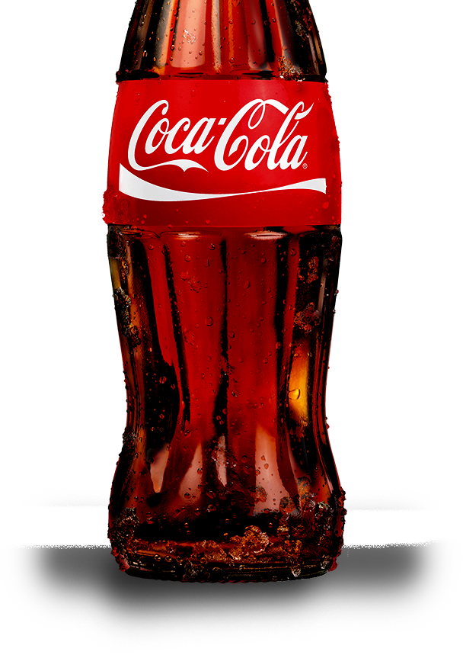
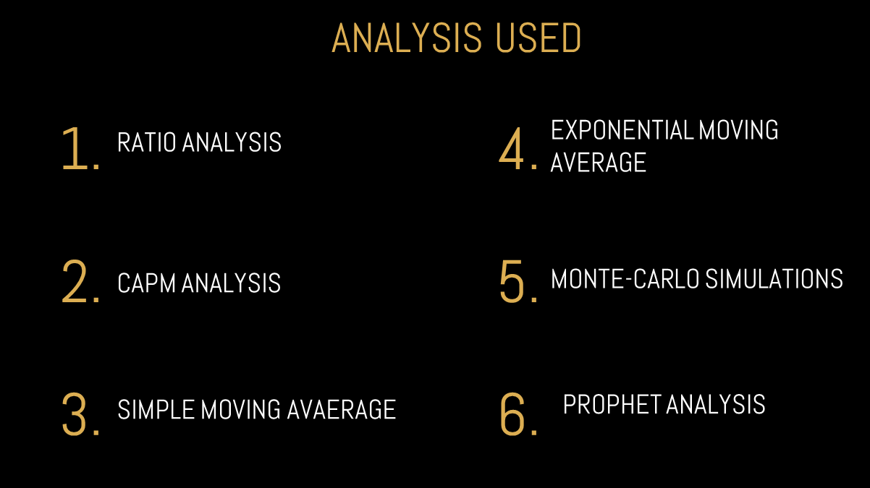

Slide 7
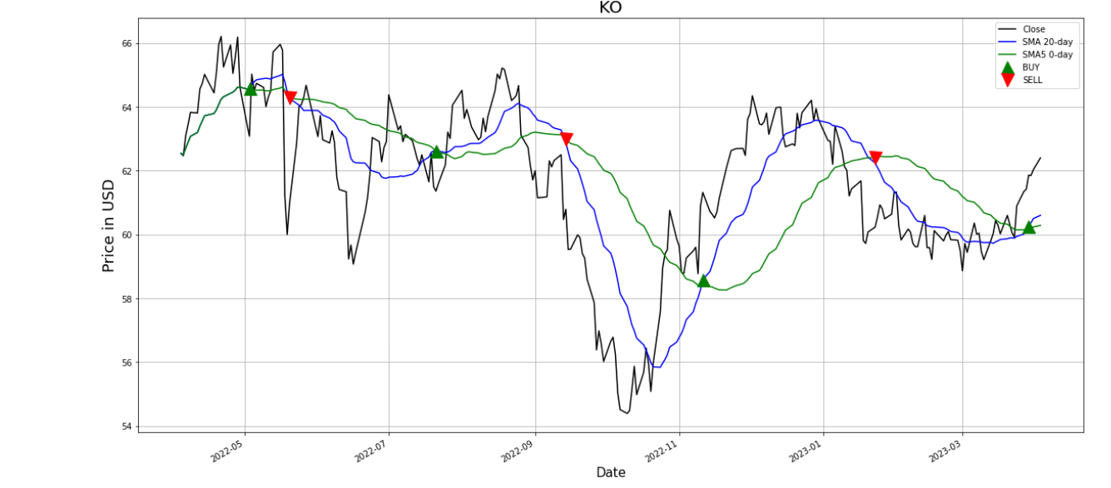
Simple Moving Average
SMA, or Simple Moving Average, is a popular technical analysis tool used to identify trends and analyze the performance of financial assets. It is important in financial analysis because it can provide insights into the momentum of a stock or market and help traders and investors make informed decisions about when to buy or sell. SMA can also help to identify support and resistance levels, which can be used to set stop-loss orders and limit potential losses.

Slide 8
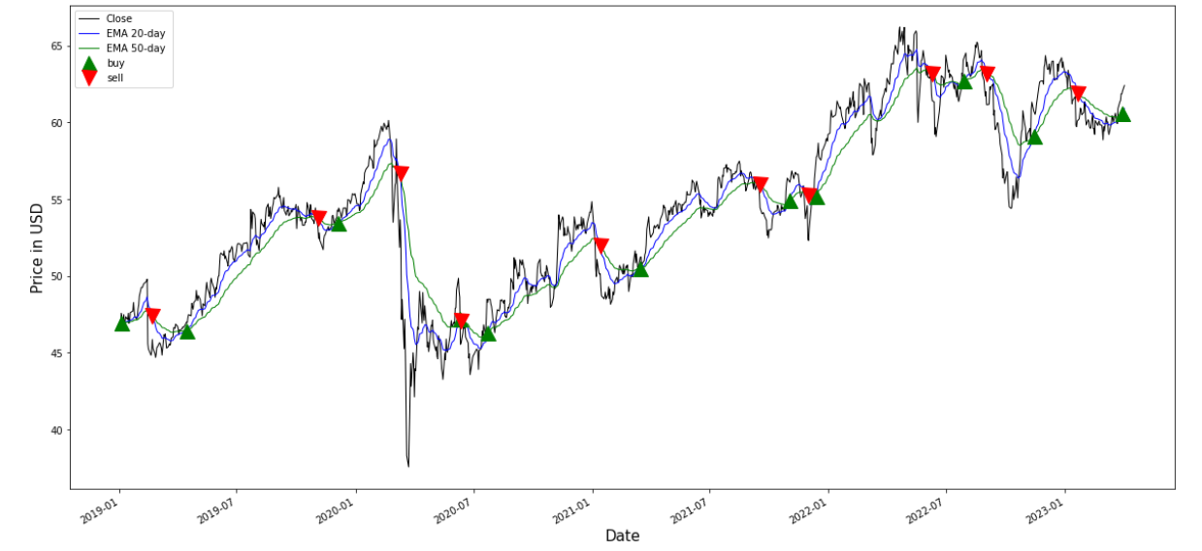
Exponential Moving Average
EMA, or Exponential Moving Average, is a commonly used technical analysis tool that helps to identify trends in stock prices. EMA gives more weight to recent prices and is useful in predicting short-term trends. It is important in financial analysis as it can help traders and investors to make informed decisions about when to buy or sell a stock based on its current trend. EMA can also be used in combination with other technical indicators to improve trading strategies.

Slide 9
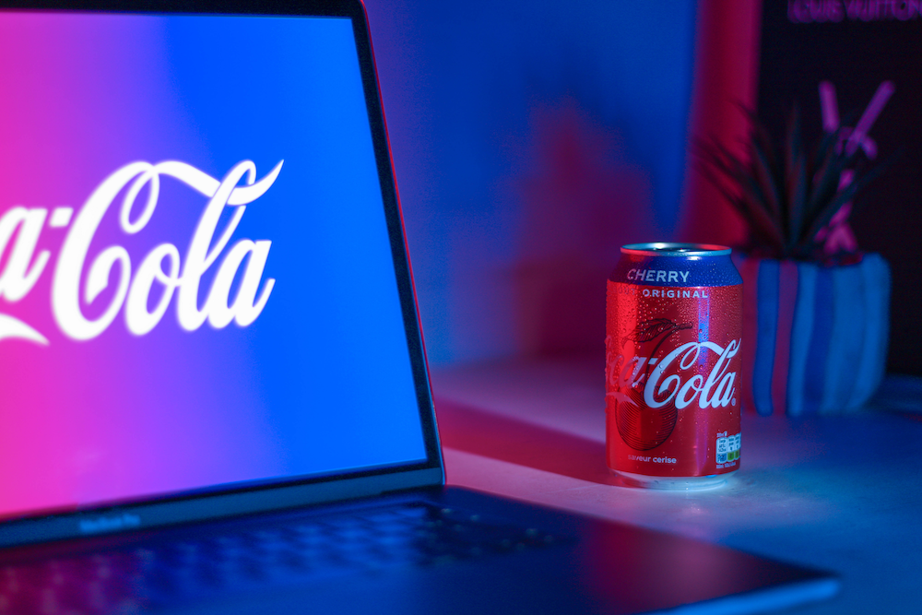
CAPM Analysis
The financial model known as CAPM, or capital asset pricing model, is used to calculate the expected return on an investment given its level of risk. The CAPM is significant in company valuation because it aids in estimating the cost of equity capital, which is one of the crucial inputs used to calculate the value of a corporation. This makes it easier for potential investors and buyers to decide whether or not to buy the firm outright.

Slide 10
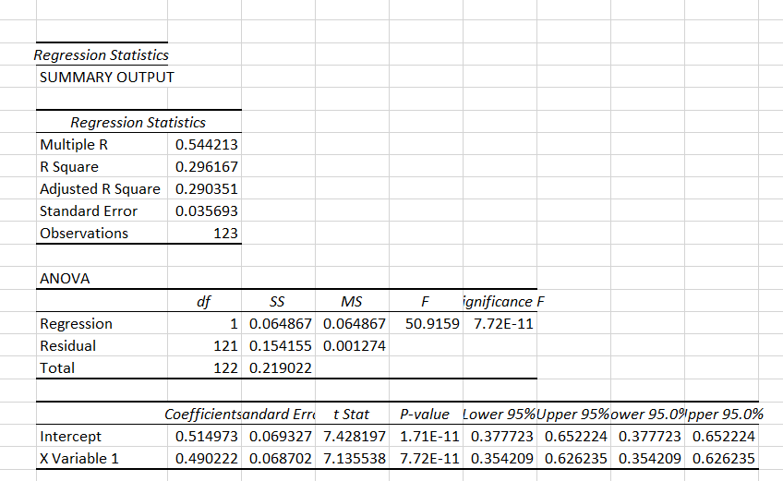
Ra = Rf + βa (Rm – Rf)
Where:
Ra = the required/expected return for the asset/Investment
Rf = the risk-free rate
βa = the beta of the asset/Investment
Rm = the expected market return(market risk premium)
To calculate of KO we used regression analysis in excel to determine beta which is 0.49 and Rm which is 10.33%, the risk free rate(3.3) is extracted from Coca Cola’s financial summary. If Beta is less than 1 then we can say that the stock is less volatile than the market.
Thereafter calculating Ra = 3.3+0.49(10.33-3.3)
The value we got for our Ra is 1.73

Slide 11
Prophet
Prophet is a time-series forecasting tool developed by Facebook that uses an additive model to provide highly accurate predictions for various data-driven applications, including financial forecasting. Its importance lies in its ability to handle seasonality, trends, and holidays in data, making it a valuable tool for financial analysts to predict market trends, stock prices, and other financial metrics accurately. Its user-friendly interface and open-source nature also make it accessible and adaptable for various financial analysis needs.
It helps businesses to make informed decisions based on future projections and improve their financial planning, budgeting, and resource allocation.

Slide 12
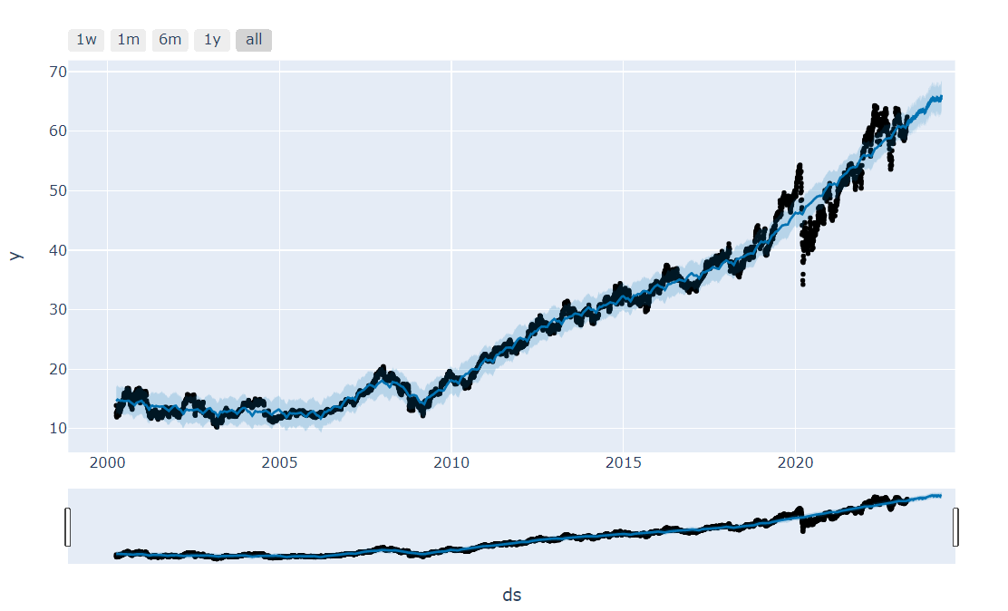
The graphs generated by Facebook Prophet show the historical trend and seasonality of Coca-Cola's stock price over time, as well as the forecasted trend and seasonality for future periods.
The graph may include a shaded area representing the uncertainty interval of the forecasted values, indicating the range of possible outcomes for the forecast.

Slide 13
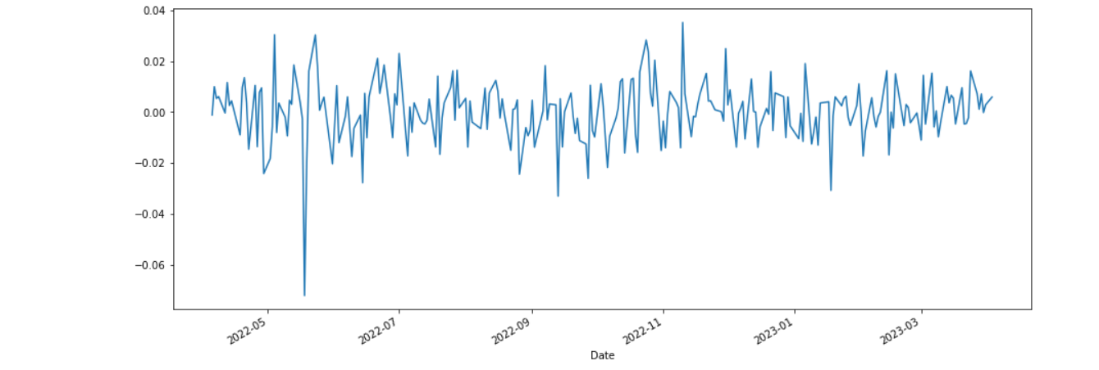
Monte-Carlo Simulations
Monte Carlo simulations are particularly helpful in finance for option pricing, portfolio optimization, and risk management. They let financial analysts and investors test various hypotheses, gauge the likelihood of certain outcomes, and make better investment decisions.

Slide 14
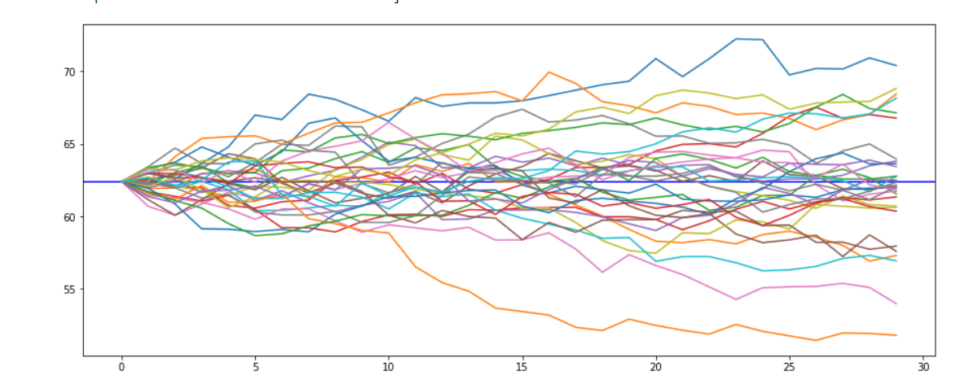
The predicted range of Coca Cola’s stock price between 50 to 70 at the 30th day is based on the results of Monte Carlo 100 simulations.
The range of 50 to 70 represents the minimum and maximum predicted values of the stock price at the 30th day, based on the 100 simulations. This means that there is a high likelihood that the stock price will fall within this range.

Slide 15
RATIO ANALYSIS
The current ratio of 1.15 and quick ratio of 0.93 indicate that the company has enough current assets to cover its current liabilities, and the cash ratio of 0.59 suggests that the company has enough cash and cash equivalents to pay off its short-term obligations.
The gross profit margin of 58.14% and operating profit margin of 28.02% are also healthy, indicating that the company is generating a good profit from its sales. Additionally, the return on assets (ROA) of 10.29% and return on equity (ROE) of 39.59% suggest that the company is effectively using its assets and equity to generate profits for its shareholders.

Slide 16
The inventory turnover ratio of 4.7 and accounts receivable turnover ratio of 12.3 also indicate that the company is efficiently managing its inventory and collecting payments from its customers.
The debt to equity ratio of 1.62 suggests that the company has more debt than equity, which may increase financial risk. However, the solvency ratio of 16.14% indicates that the company has enough assets to cover its liabilities.
The current price-to-earnings (P/E) ratio of 28.2 suggests that the stock may be slightly overvalued compared to its earnings per share (EPS) of 2.20.

Slide 17
INFERENCE
The Coca-Cola firm is a parallel business with light and heavy assets in terms of financial strategy, and this has an impact on how the firm will operate going forward.
However, in recent years, people's awareness of the value of health and the emergence of health consciousness has increased. The beverage sector has seen significant trends in the use of zero sugar and reduced sugar. Additionally, people are developing a resistance to drinks with added sugar.
Coca-Cola might attempt to improve its product line in the future by producing more sugar-free and low-sugar beverages and boosting its spending on environmental budgets and initiatives . By leveraging Coca-Cola's brand, a positive impact may be established that will be more beneficial to current business circumstances. By combining the conclusions, it can be said that Coca-Cola is both extremely successful and distinctive.

Slide 18
Combining the conclusions, it can be said that Coca-Cola is both extremely successful and distinctive.
Investing in Coca-Cola has the potential to generate bigger returns, but doing so also entails taking on a higher degree of risk, according to the different ratios and the findings of the CAPM and Monte Carlo simulations. However, over time, the company's sales, gross profit, and valuation have all steadily increased. As a result, it is clear from the financial analysis that Coca-Cola is a very strong firm with a lot of revenue.

Slide 19
THANK YOU

